Slide 1
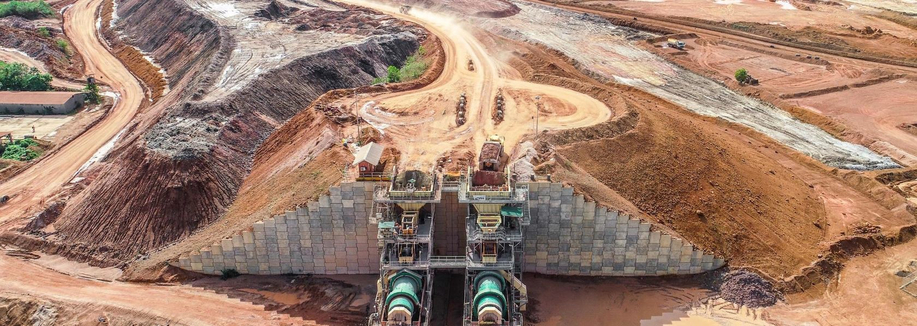
Company Profile
A boutique provider of Mining Project Owners Team Services and Resources

Slide 2
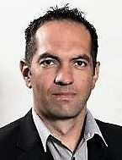
Background to Project EQ
Project EQ was established in 2014 in response to a growing need for competent Owners’ representation services in the mining industry.
The Founding Member of Project EQ, Jan Booyse, is an Extractive Metallurgist and Project Management Professional (PMP) with over 22 years’ experience in mine operations management, EPCM and project owners team roles. Commodity experience includes gold, diamonds, PGMs, iron ore, bauxite, tin and heavy mineral sands.
Project EQ has built its business around sustainable relationships, a flexible approach and an unwavering commitment towards value creation. As a niche service provider, our philosophy has remained to remain small and focused, flexing around our clients’ requirements.

Slide 3
The Problem
Project Resourcing
Mining companies often lack the specialist skills and capacity to effectively manage capital projects​. This may lead to an over-reliance on the Engineering contractor, who may have conflicting interests
Business case Awareness
Many projects fail to clear investment hurdles due the lack of focus on cost-effective functionality​ and avoidance/ deferral of discretionary extras
The Brain Drain
The mining and EPCM industries have seen a severe depletion of skills over the past 2 decades, with the exodus of skills due to emigration and retirement, not adequately
offset by the next generation.
The result is an increasing requirement for project owners to exercise effective assurance over their projects
Core Business Focus
Project owners often attempt to resource projects from existing staff often ill-equipped for the challenges and complexities of capital project management, diluting the focus on core business.
Inflexibility
Projects are by their very nature short term endeavors, with varying resource needs through the life cycle. Owners invariably are challenged to strike the right balance due to onerous on- boarding and offloading of resources

Slide 4
The Solution
Dedicated Owners Teams
End-to-end value creation
Our service offering that extends
Project Assurance
Owners’ teams bridge the gap between project owners and EPCM companies and ensure that Owners’ interests are prioritized.
Specialist resources with intimate knowledge gained working for EPCM companies empower project owners to exercise critical assurance over project deliverables
from project conceptualization to full operations, and every step in between
Flexibility
Just-in-time resourcing, adapting to constantly evolving resource demands and flexible onboarding and demobilization solves complex problems for mining companies in a skills-depleted environment.

Slide 5
Our Services
Owners Team Representation
We provide end-to-end multi-disciplinary owners team representation services for mining projects, effectively acting as an extension to the Client’s team
Project Assurance Services
Our Project Maturity Assessment services provide owners with a factual account on project health status, a gap analyses of required vs actual maturity and recommended interventions
Resource placement
Our Resource Placement services are differentiated by our intimate understanding of Owners needs. We recruit exclusively from our own network of specialist resources
Boutique Engineering Services
We provide limited front-end engineering design services in-house to inform investment decisions
Our Operational Assurance services focusses on identifying compliance to best practice and identifying opportunities for improvement
Operational Audits

Slide 6
Our Team
Jan Booyse
Managing Director
CJ van den Berg
Lead- Project Delivery
Andre Nel
Lead- Commercial
Leon De Kock Lead- Project Controls
Brett Cocks
Lead- Process
Tom Steytler
Lead: HSE

Slide 7
Our Differentiators
As Metallurgists we are heavily invested in ensuring the process works and the ultimate investment objective is achieved
Process Focus
Exposure both sides of the table
We have extensive experience in managing operations as clients, as well as the execution of projects as part of EPCM teams. This provides us with an unparalleled ability to provide leadership and assurance on all execution fronts
Value Engineered Mindset
We have a proud track record in unlocking value in projects, which is often the difference between marginal projects clearing the investment hurdles or not
We are firm believers in effective front-end loading and a structured stage-gate approach to the development of projects. This ultimately protects shareholder value and ensures maximum project returns
Disciplined approach
We ultimately have one goal, which is adding value to our clients. We constantly review and adapt our service offering to assist our clients’ needs
Flexibility

Slide 8
Our Clients
Project EQ has been servicing a diverse range of clients, spanning multiple commodities and continents. Our portfolio includes Junior mining companies to Majors, as well as EPCM firms.

Slide 9
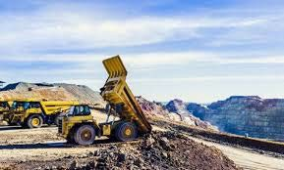
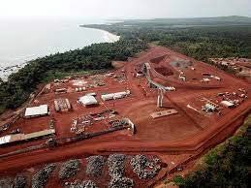
Conclusion
Project EQ seeks to address a key deficiency in the delivery of capital projects in the mining industry: Effective Owners team Representation and
Our track record demonstrates our focus on the provision of cost effective, tailored services which unlocks value for our clients and results in predictable project outcomes.

Slide 10
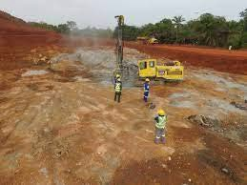
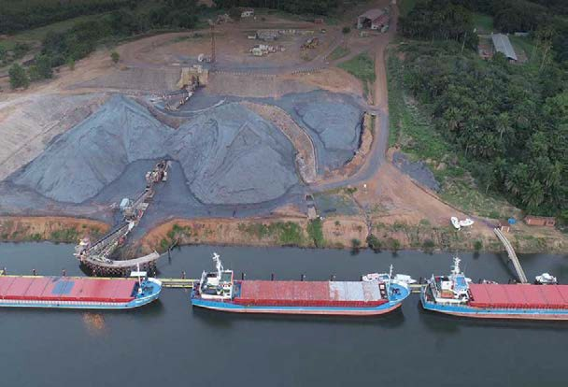
Contact Us
Jan Booyse
+2782 563 4238
janb@project-eq.com
10

